Slide 1

COVID-19 and its Economic Predictors
Joe Rodini
A Project for Data Analytics Bootcamp, University of Oregon, 2022
Notes:
Hello, and welcome to the presentation of my final project for the University of Oregon data analytics bootcamp. For my topic I chose to investigate economic predictors of COVID-19 outcomes.

Slide 2
Project Overview
Notes:
Here’s some background information about my topic and why it was chosen.

Slide 3
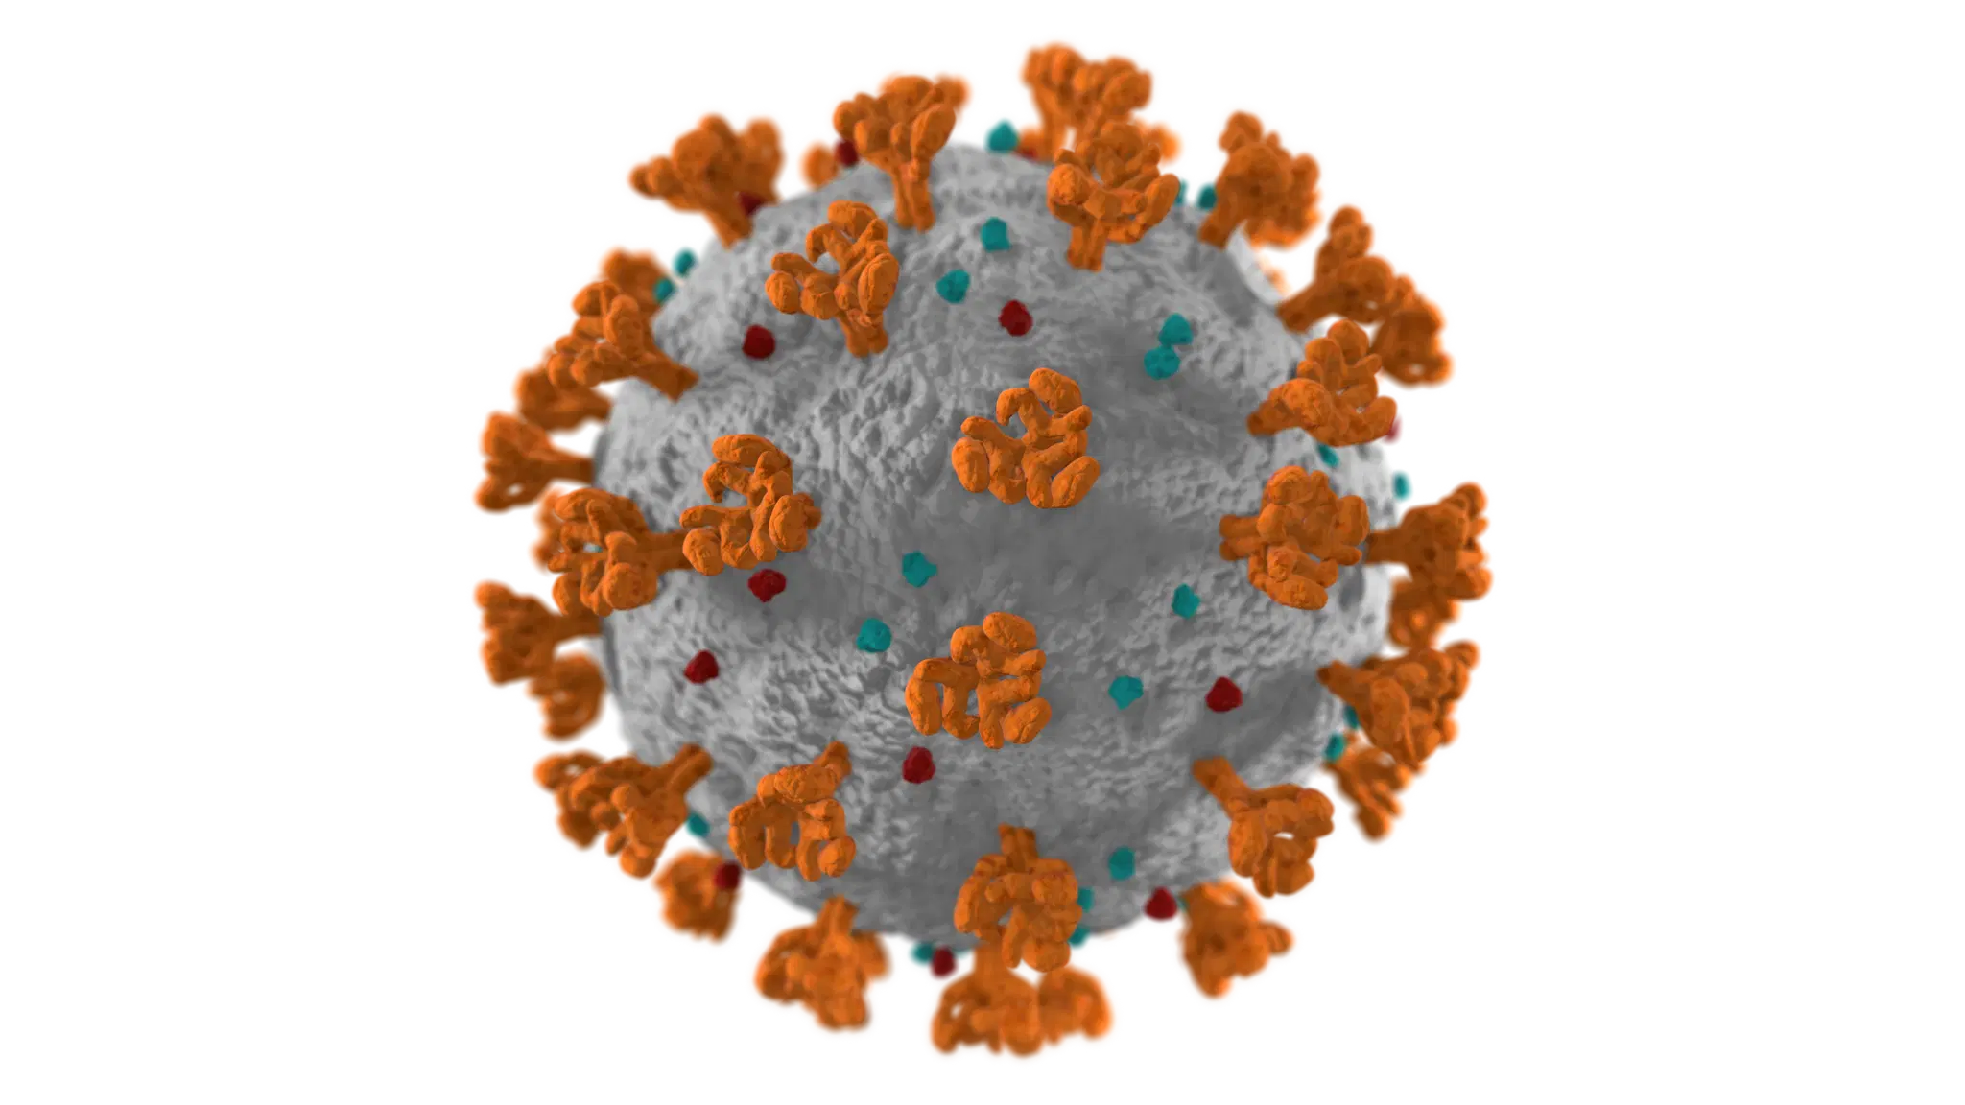
Background
Coronavirus disease (COVID-19) is an infectious disease caused by the SARS-CoV-2 virus, first identified in Wuhan, China in December 2019
It spread to the level of a global pandemic by March 2020
While a report often cited by the White House in May 2020 estimated a national death toll of 134,000 from the virus, current estimates of the US death toll is over 1,000,000
Notes:
The COVID-19 pandemic has affected every aspect of our lives since its declaration in March 2020, and has proven much more communicable and deadly than was initially estimated, with over a million US deaths reported.

Slide 4
Economic Differences
In 2021, the top 10 percent of Americans held nearly 70 percent of U.S. wealth, while the bottom 50 percent owned about 2.5 percent of wealth.
Unemployment rate, defined as the percentage of people of the labor force that is not currently employed but could be, is an indicator of economic health and a signal of potential recession.
Median Household Income is a well-recognized indicator of poverty, which can affect physical and mental health.
These two measures will serve as my predictors
Notes:
It is also apparent that there are certain differences and disparities within our country’s economy. Distribution of wealth is far from equal, for example. Two economic metrics of note are unemployment rate and median household income. The former can indicate economic health and the later has implications for physical and mental health. As these two metrics are important and available from the US Department of Agriculture, I chose them as my predictors for this project.

Slide 5
Research Question
How well can the economic indicators of unemployment and median income, measured at the county level, predict COVID outcomes?
COVID outcomes:
Cases per 100,000
Deaths per 100,000
Vaccination Rate
Notes:
I sought to see if the economic indicators, measured at the county level, could predict the following three COVID outcomes: Cases per 100,000 people, deaths per 100,000 people, and vaccination rate, expressed as a percentage of the population.

Slide 6
Technologies
Coding
Python, Pandas in Jupyter Notebook; SQLAlchemy
Database
PostgreSQL in PgAdmin
Visualizations
Tableau, Plotly
Notes:
The technologies I utilized included Python, Pandas, and SQLAlchemy for coding purposes, PostgreSQL for database purposes, and Tableau and Plotly for visualization purposes.

Slide 7
Working with Data
Notes:
Here’s an overview of the datasets and how I worked on them.

Slide 8
Data Sources
There were four main sources that comprised this analysis:
Data on county vaccination rates from https://data.cdc.gov/Vaccinations/COVID-19-Vaccinations-in-the-United-States-County/8xkx-amqh
Data on county cases and deaths numbers from https://github.com/nytimes/covid-19-data
Data on county economic factors from https://www.ers.usda.gov/data-products/county-level-data-sets/download-data/
Data on county coordinates and population from https://simplemaps.com/data/us-counties
All four data sources were obtained as CSV files
Notes:
Four main sources of data comprised this analysis:
County vaccination data from the CDC
County case and death numbers from the New York Times
County economic factors from the Department of Agriculture
And county coordinates and population from a demographics site
All four data sources were obtained as CSV files.

Slide 9
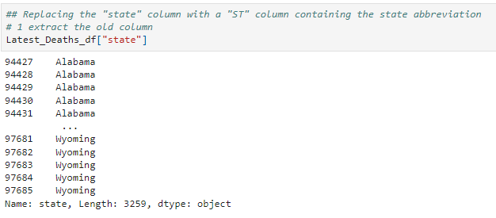
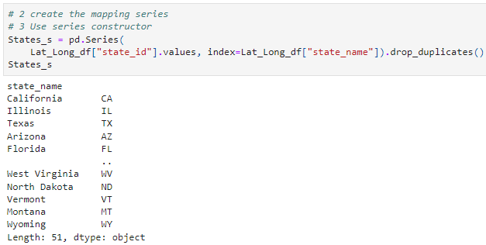
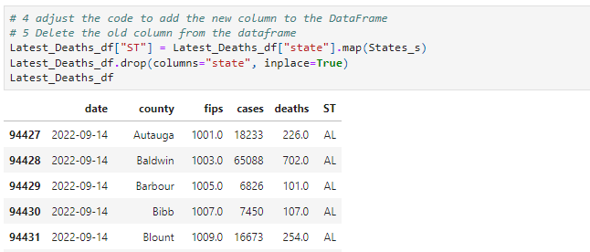
Data Exploration: Cases/Deaths
Across the four datasets, I included a ST column for consistency. Here, doing so for the cases/deaths data.
Notes:
I will now give an example of data cleaning for each of the four datasets I used.
First, I included a state abbreviation column, titled ST, for each dataset for consistency purposes. Here, with the cases/deaths dataset, this entailed mapping a series of state abbreviations from another dataset then dropping the column with the full state name.

Slide 10
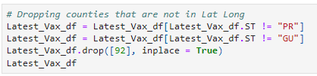
Data Exploration: Vaccination Rate
I chose to only use data for the 50 states (territories had incomplete data). Here, dropping rows for Puerto Rico and Guam.
Notes:
For the vaccination rate dataset, I dropped data for US territories as they were not present in other datasets.

Slide 11
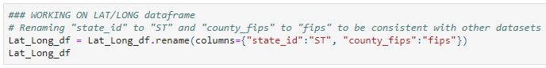
Data Exploration: Latitude/Longitude
I ultimately joined the tables under the “fips” column, so here I first renamed the column across the datasets to be consistent.
Notes:
As you will soon see, the fips column, which in a nutshell is a unique identification number given by the federal government to each US county, was chosen as the key for each table to be merged, with the primary key being contained in the coordinates dataset. Here I rename the column in the coordinates dataset to be consistent with the other datasets.

Slide 12
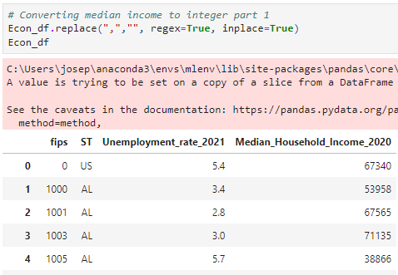
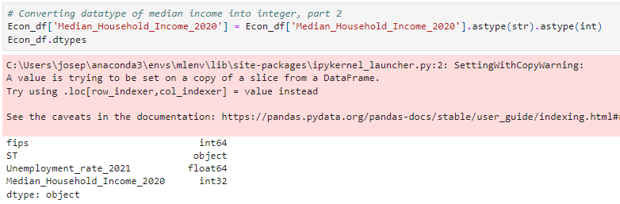
Data Exploration: Economic Indicators
Commas had to be dropped from median income data in the economics data.
Notes:
Finally, I had to do some reformatting in the economics dataset. To perform statistical analyses for he median income, commas had to be dropped from the figures and the datatype converted to an integer.

Slide 13
Database
Notes:
With the data looking good, it was time to import it to a database.

Slide 14
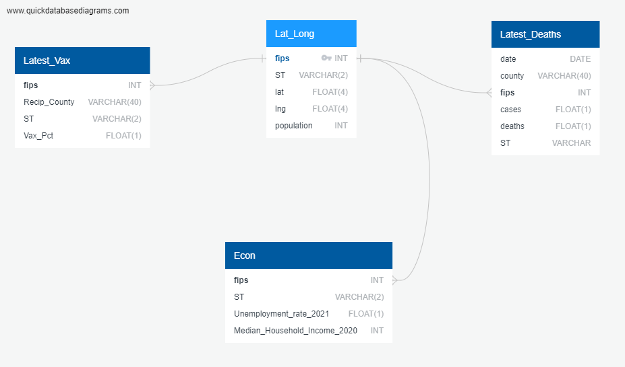
Entity Relationship Diagram (ERD)
Notes:
Here is the entity relationship diagram for my data tables. As previously mentioned, the latitude longitude table held the primary key of fips, with all other tables having fips as a foreign key by which they were linked to the latitude and longitude table.

Slide 15
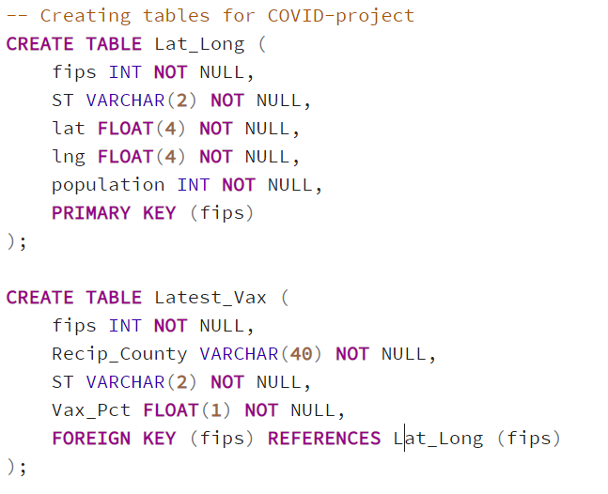
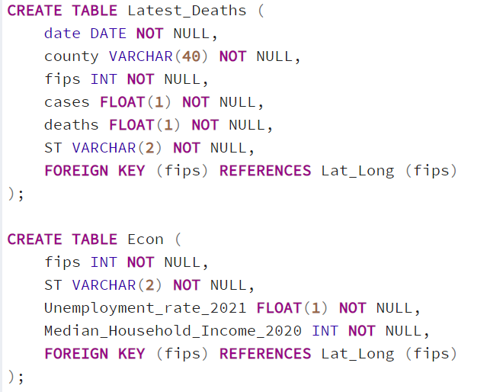
Creating Tables in SQL
Notes:
Here you can see the queries that created the tables in SQL.

Slide 16
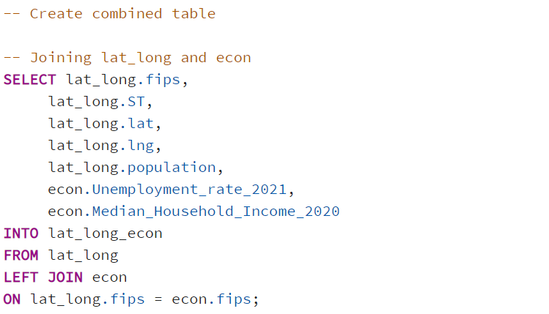
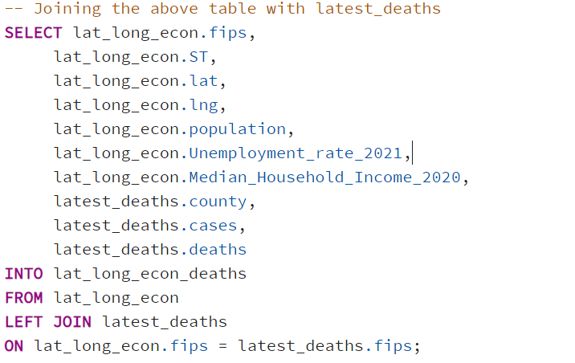
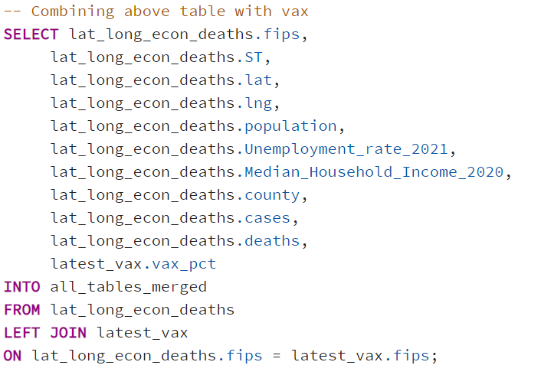
Merging Tables in SQL
Notes:
These are the queries that then merged the four tables, which needed to happen in order to create the calculated variables of cases per 100,000 people and deaths per 100,000 people.

Slide 17
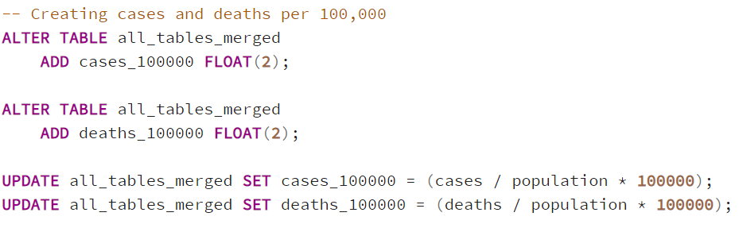
Creating Cases and Deaths per 100,000
To create a rate similar to vaccination rate, I used the population data to calculate cases and deaths per 100,000 people in the counties.
Notes:
To create per capita rates allowing us to compare counties against one another, I used population data to create the calculated columns of cases and deaths per 100,000.

Slide 18
Data Analysis
Notes:
I was then ready to analyze the data.

Slide 19
Descriptive Statistics
 | Unemployment | Median Income | Vaccination Percentage | Cases per 100,000 | Deaths per 100,000
Mean | 4.64 | $57,364.90 | 52.15% | 28,296 | 395
SD | 1.74 | $14,545.63 | 12.43% | 7,711 | 164
Median | 4.4 | $55,044.00 | 59.43% | 28,025 | 390
Notes:
Here are some summary statistics of the main variables I investigated. As you can see, there is significant spread in the data as indicated by the standard deviations, and measures of central tendency indicate not too much skew in the data.

Slide 20

Machine Learning: Logistic Regression
In order to perform logistic regressions, a median split was created for the following three variables: cases per 100,000 people, deaths per 100,000 people, and vaccination rate.
Notes:
Next, in order to perform logistic regressions, each of the three COVID outcome variables were given a median split transformation. A code of 0 was given to values located in the bottom 50% of the distribution, while a code of 1 was given to the values located in the top 50% of the distribution.

Slide 21
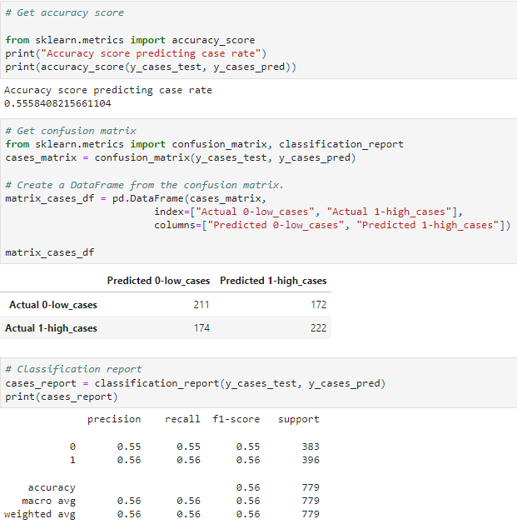
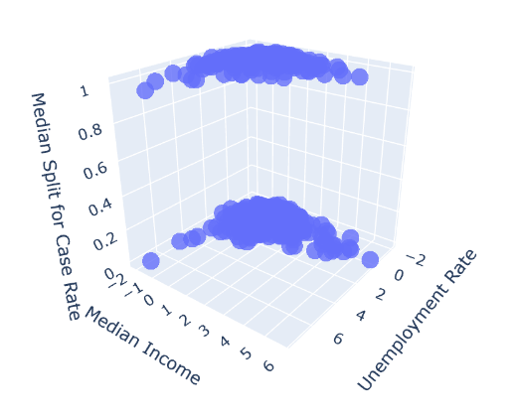
Logistic Regression: Case Rate
The model hardly performed better than chance when predicting case rate.
Notes:
The results of logistic regressions will now be reported. First, case rate was not predicted very accurately by the economic predictors, at an accuracy rate of 56%. The confusion matrix and classification report validating the model can be seen here. This low accuracy rate will also be reflected in the Tableau visualizations you will see in just a moment. We can conclude from this regression that it seems as though the COVID pandemic spread evenly throughout counties regardless of their economic status.

Slide 22
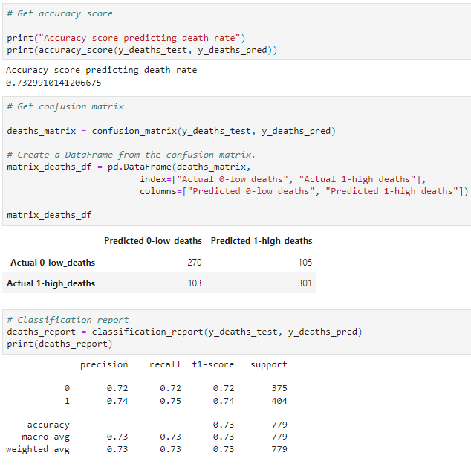
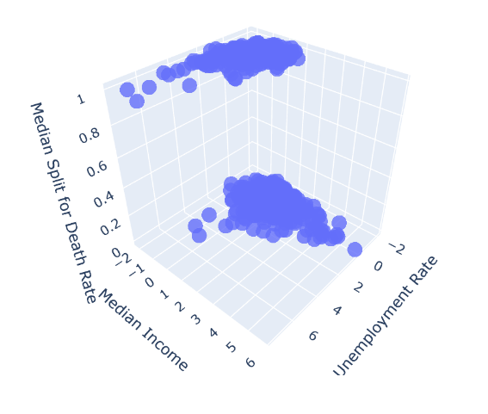
Logistic Regression: Death Rate
The model was much more successful at predicting death rate.
Notes:
The variable best predicted by unemployment and median income was death rate. The accuracy score was 73%, which is not incredibly high but still strong. You can see that the distributions of the top and bottom 50% are the most disparate of the three outcome variables.

Slide 23
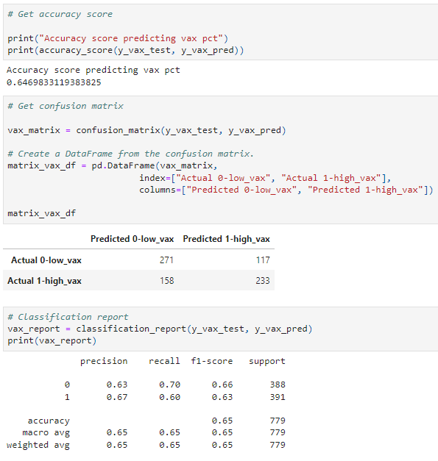
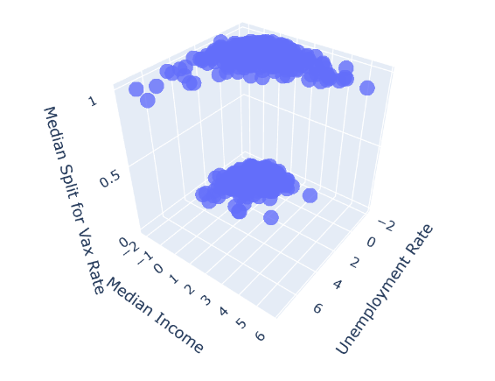
Logistic Regression: Vaccination Rate
And it was somewhere in the middle when predicting vaccination rate.
Notes:
Finally, vaccination rate was predicted at about 2/3s accuracy by the economic predictors, making the model more predictive than the one that predicted case rate, but less predictive than the one that predicted death rate.

Slide 24
Comparison to Support Vector Machines
Outcome Variable | Accuracy score LG | Accuracy score SVM
Cases per 100,000 | 55.6% | 55.3%
Deaths per 100,000 | 73.3% | 72.9%
Vaccination Rate | 64.7% | 65.0%
Next, SVM models were created in the same manner of the logistic regressions. These models performed nearly identically to the regressions.
Notes:
I then compared the performance of the logistic regressions to support vector machines. The two were nearly identical in their accuracy. So, although they work differently, they arrived at the same conclusion.

Slide 25
Visualizations with Tableau
Variable | Bin size
Vaccination Rate | 15%
Median Income | $10,000
Unemployment | 2.5%
In order to make certain visualizations, bins were created for the continuous variables of vaccination rate, median income, and unemployment.
Visualizations can also be seen at https://public.tableau.com/app/profile/joe.rodini/viz/COVID-projectvisualizations/COVID-project#1
Notes:
Additional visualizations were made with Tableau. In order to make some of them, bins were created for the continuous variables of vaccination rate, median income, and unemployment.

Slide 26
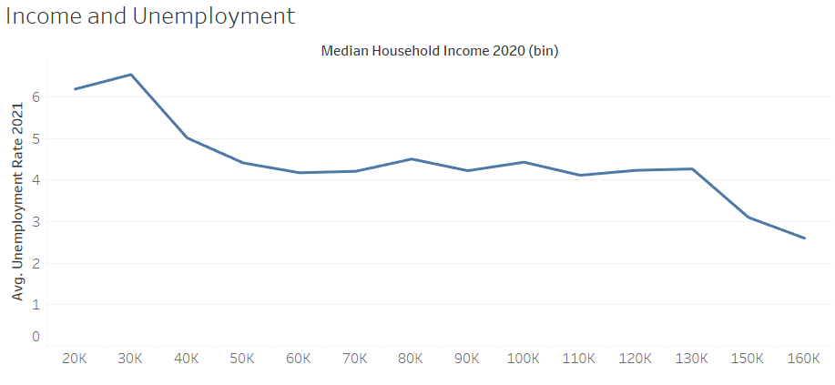
Notes:
I was curious to see if there was a relationship between my economic predictors. Looking at this line graph, a weak negative correlation can be seen, with unemployment rate going down as median income increases. This trend is quite evident at the ends of the income distribution, but for those earning around 50k/year median income to 130k, there is almost no correlation between median income and unemployment. Overall though, these variables do not need to be strongly related. It may be the case that they could both predict COVID outcomes but be orthogonal to one other.

Slide 27
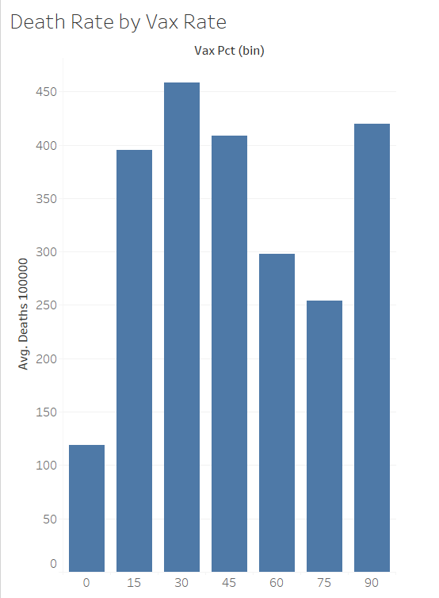
Economic Predictors of COVID Outcomes
Notes:
Next, I wanted to see if there was a clear relationship between my COVID outcomes. This chart shows the average death rate across binned vaccination rates. This graph is the hardest of all to interpret. It seems as though, apart from the extremes, there is a negative relationship between death rate and vaccination rate, that is, as vaccination rate goes up, death rate goes down. However, it looks like the opposite relationship holds at the ends of the vaccination rate distribution–the counties with the lowest death rate have the lowest vaccination rate, and the counties with the highest vaccination rate have some of the highest death rates. This must be a product of population density. It must be the case that highly populated areas are prone to high death rates even if they have high vaccination rates. This finding likely muddied some of my other relationships.

Slide 28
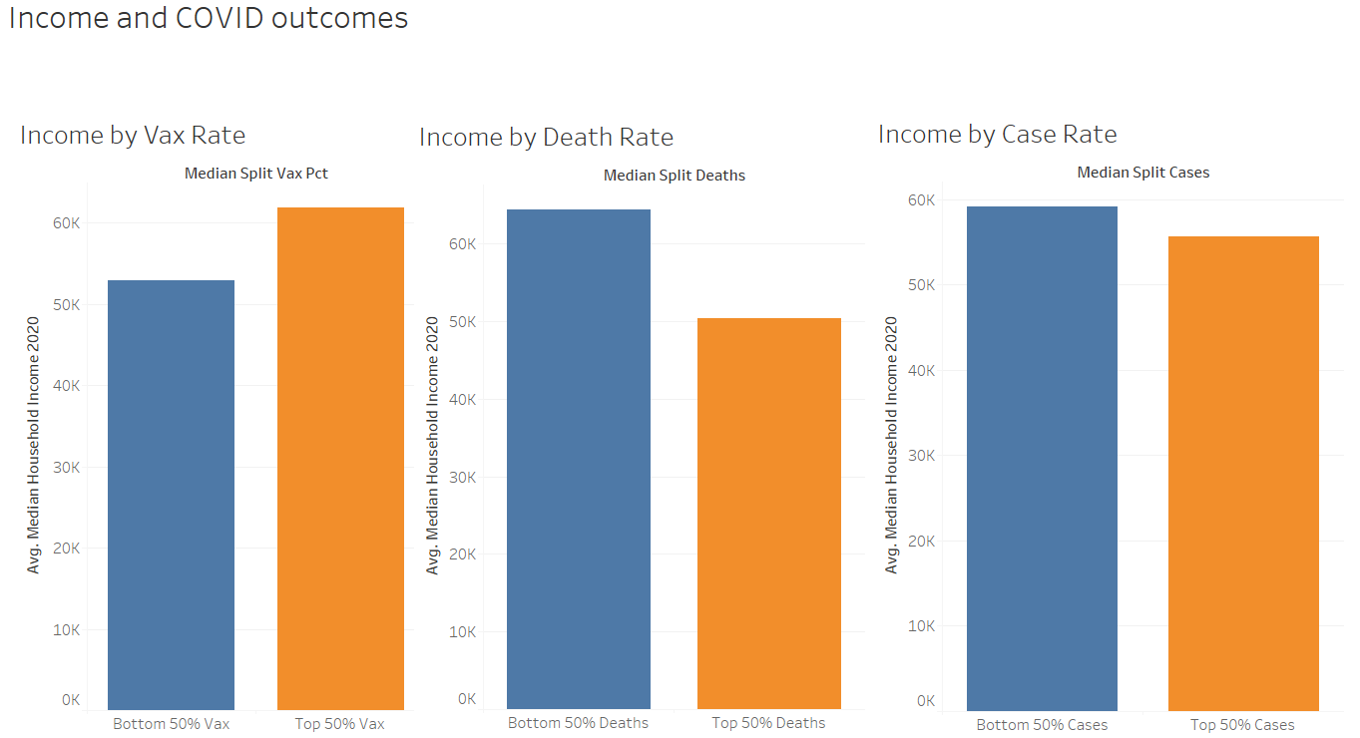
Notes:
Here we see the relationship between median income and our COVID outcomes, with the median split being seen on the X axis and the median income on the Y axis. As you can see on the right, it was the hardest for the machine learning models to distinguish between high and low case rate as those two groups did not differ by much in median income. Moving on to the left graph, the relationship between income and vaccination rate proved stronger, with the higher income group having a higher vaccination rate. Finally, the strongest relationship was seen between median income and death rates, with the lower death rate group having a much higher average income than the higher death rate group.

Slide 29
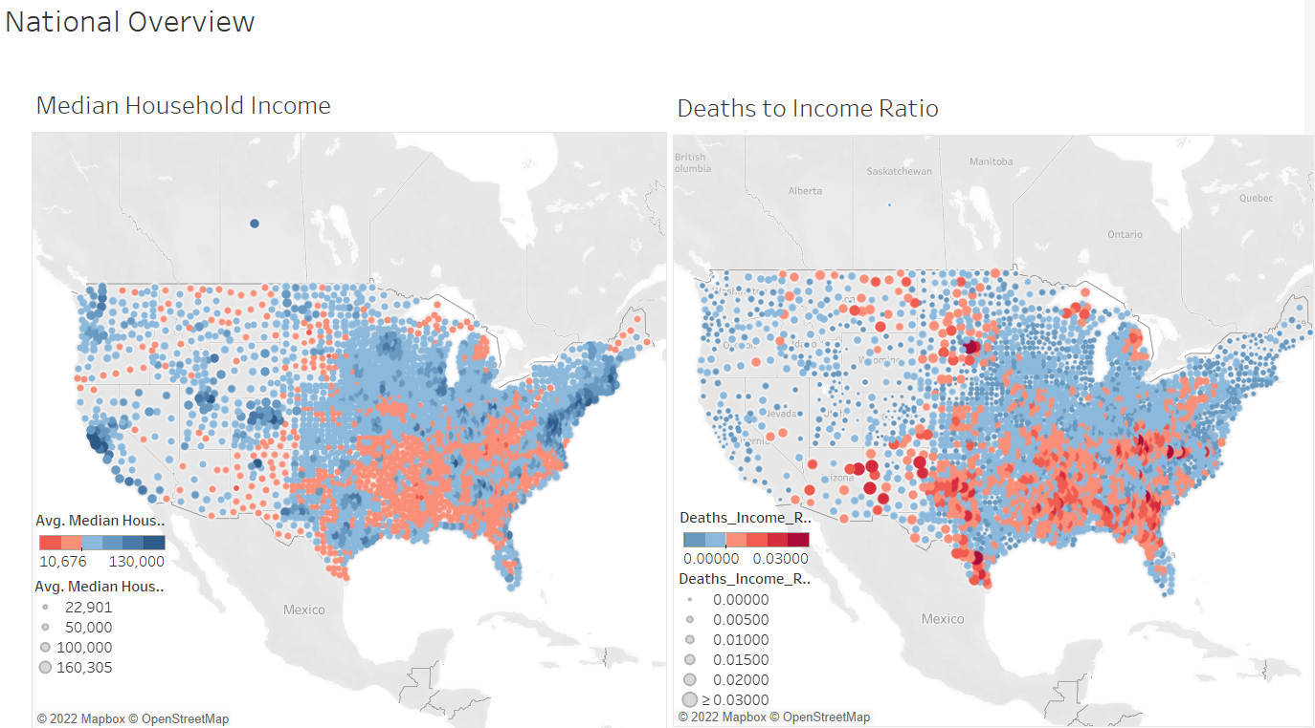
Notes:
Using the fips codes and latitude and longitude, we can see some trends mapped out nationally. On the left is a visualization of median household income across the country, with lower incomes indicated by smaller and redder dots than the larger, bluer dots of higher incomes. Next, I wanted to see if I could visualize at the national level a relationship between income and death rate. To do this I calculated a variable I called deaths to income ratio, where I divided the death rate by the median income for each county. If the expected relationship exists, the same counties that were low in income would have a high deaths to income ratio. This is exactly what I found, as the two graphs look very similar.

Slide 30
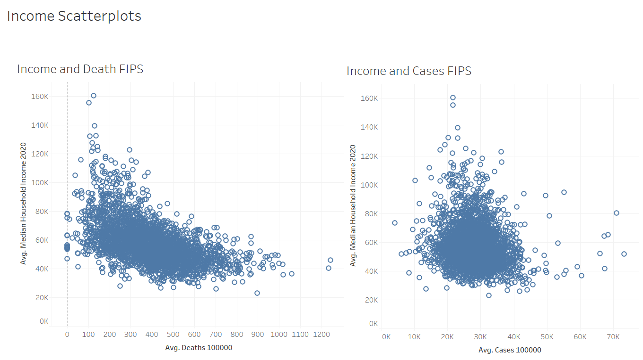
Notes:
Finally, I wanted to corroborate the results from the machine learning models at the county level, so I made scatter plots that show a much stronger (negative) relationship between median income and death rate as compared to between median income and case rate.

Slide 31
Conclusions
Notes:
So what have we learned today?

Slide 32
Economic Predictors and COVID Outcomes
Case rate was not well-predicted by economic indicators, meaning that the spread of COVID was fairly uniform across the country regardless of economic level.
However, death rate was well predicted by economic indicators, demonstrating that counties with more economic resources were better able to mitigate the pernicious effects of the pandemic.
Vaccination rate was somewhat well predicted by economic indicators, suggesting that counties with more economic resources did somewhat of a better job getting their populations vaccinated.
Notes:
We learned that our economic predictors did not have the same success at predicting our three COVID outcome variables. They were least successful in predicting case rate, most successful at predicting death rate, and somewhat successful at predicting vaccination rate. This points to a trend that COVID spread mostly equally throughout the country, while counties with stronger economies were better able to vaccinate against it and prevent deaths.

Slide 33
Next Steps
Additional analysis would continue to shed light on this topic.
Factors that might have obscured the relationship between economic predictors and COVID outcomes might include: population density, political affiliation, education level, and ethnicity
Correlation is not necessarily causation–it could be that other variables, such as the ones above, cause the economic predictors and COVID outcomes to show a relationship
Notes:
There are obviously more factors that determine COVID outcomes. Some of those factors suggested by this analysis include population density, political affiliation, education level, and ethnicity. Finally, correlation is not necessarily causation in this case; it could be that a third variable, such as one of the ones just mentioned, cause the economic predictors to covary with the COVID outcomes, particularly death rate.

Slide 34
Thank You!
Notes:
Thanks for your time and attention, and I hope this project was informative!

